Slide 1
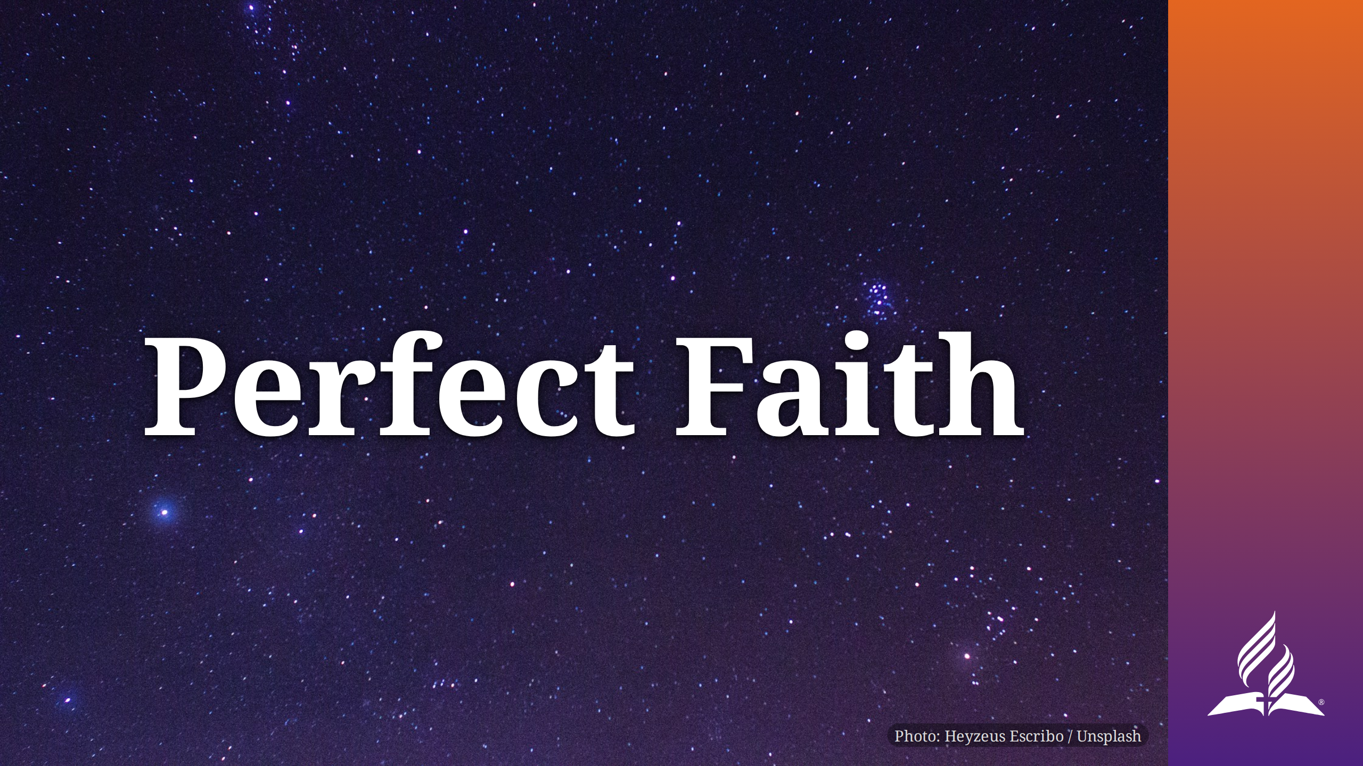

Slide 2
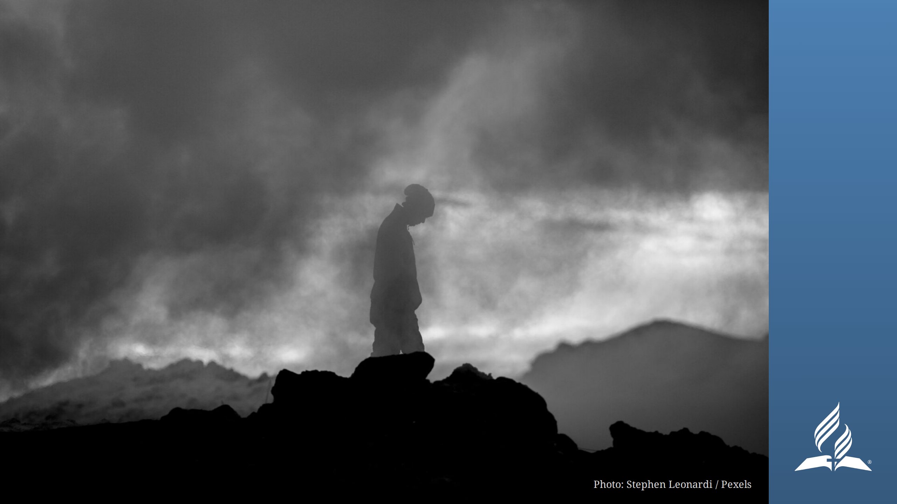
Notes:
Have you ever wondered whether you had enough faith? Maybe you've wondered
whether God would actually come through for you. Perhaps you have some nagging
questions or doubts that unsettle you.
Maybe you've wondered whether your doubts or lack of faith might cause you to
miss out on eternal life. Today we're going to look at a passage in the book of
Romans that may surprise you, and its implications are far-reaching. And we're
going to look at someone who had perfect faith, even though we can find plenty
of imperfections.
Background: Paul begins Romans by explaining that everyone—those who have the
law as well as those who don't—has sinned. Sin brings death. Then, he begins to
talk about the solution.

Slide 3
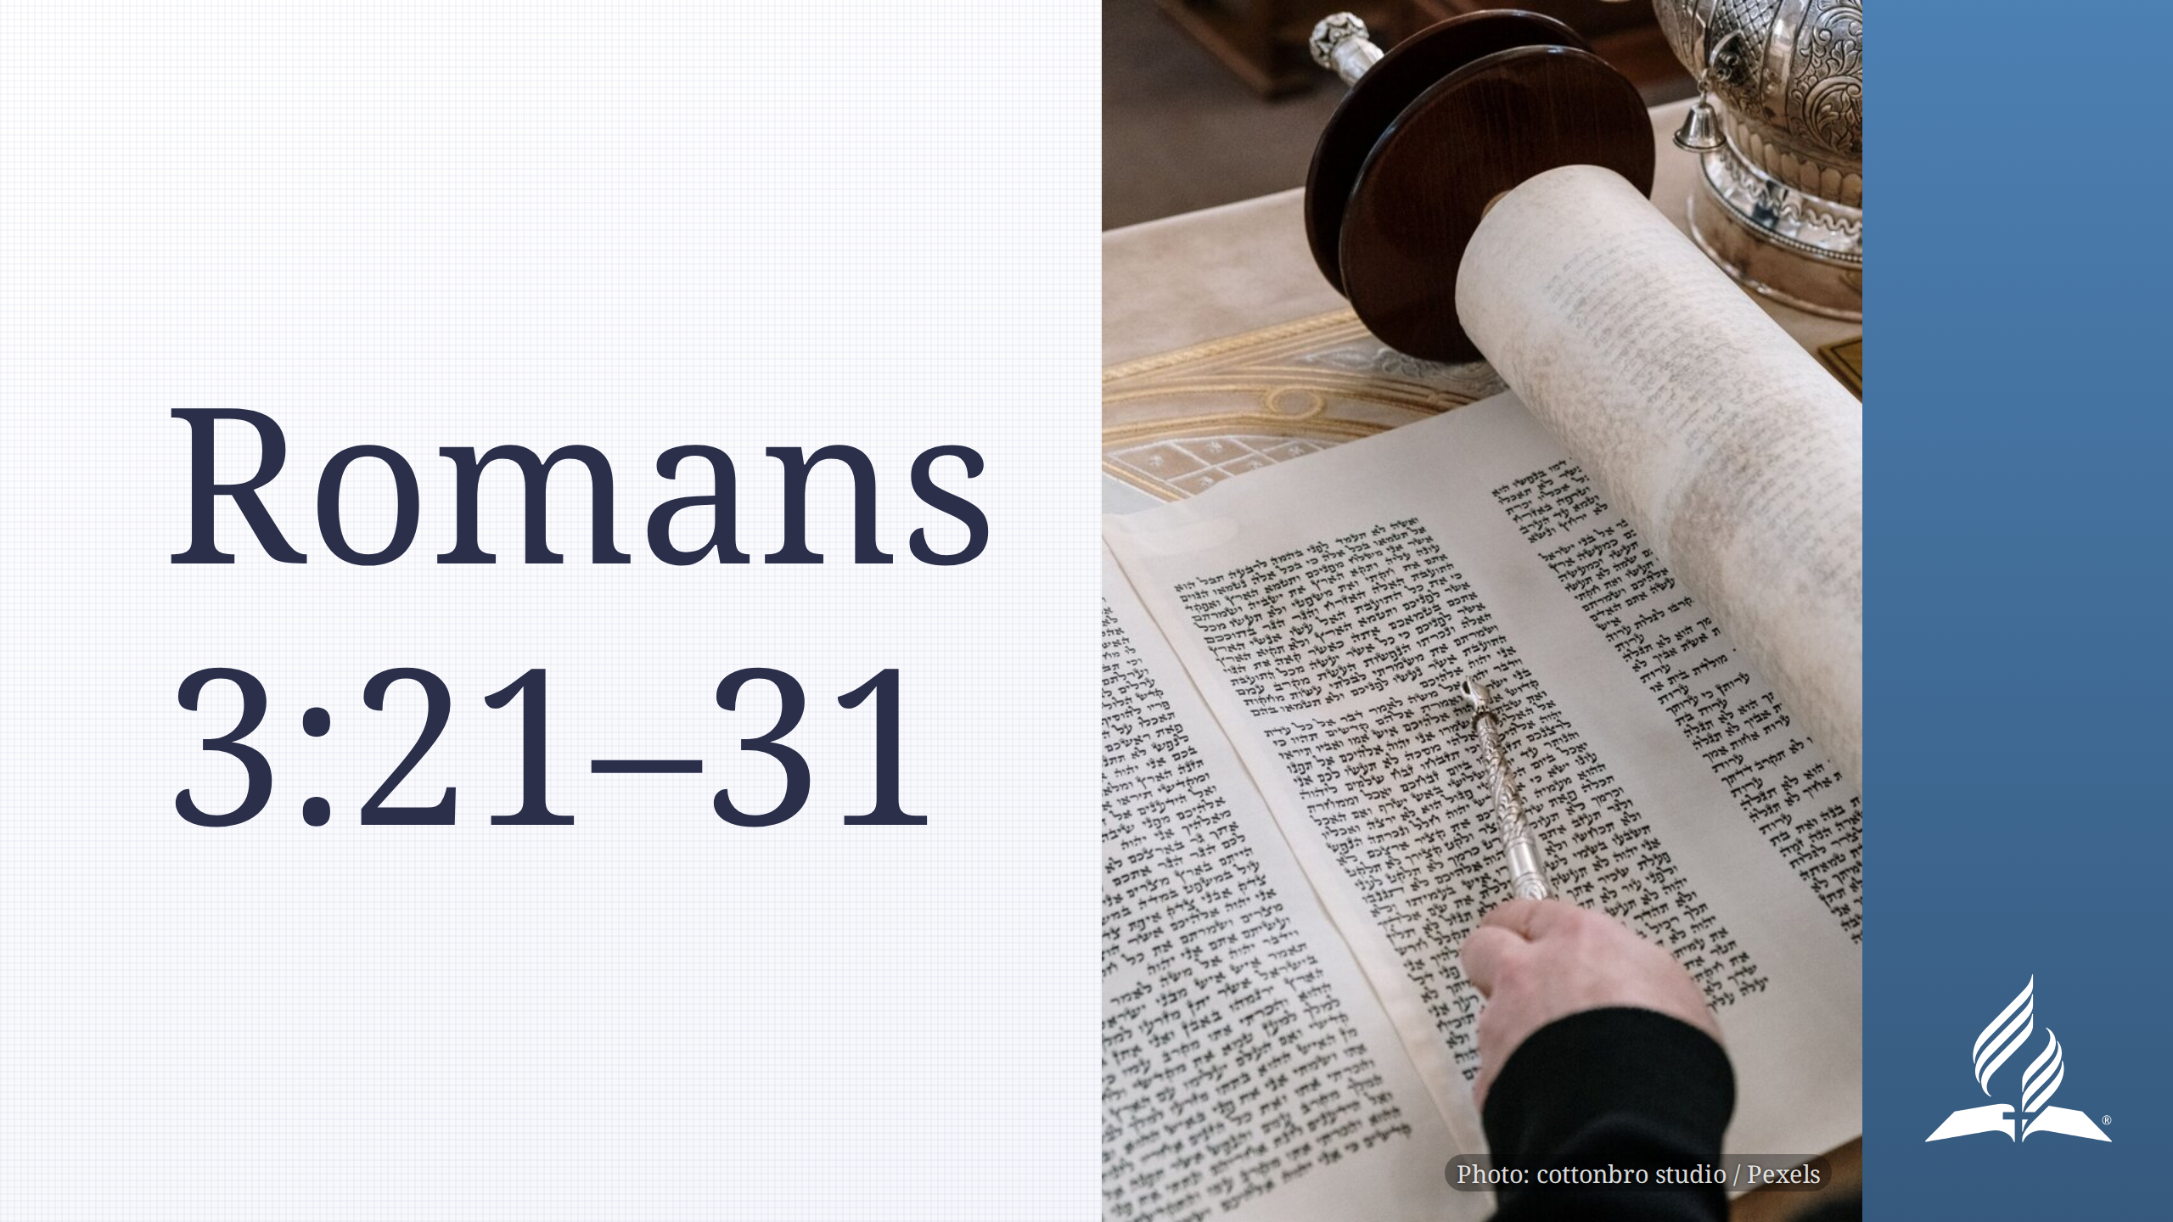
Notes:
God's righteousness is greater than the law. This is why Jesus' death makes
us righteous (vv. 23, 24).
Because of God's work, we have no reason to boast (v. 27). Salvation was never
about keeping the law and it was never something that we could earn. We can
only accept it by the law of faith (v. 28).

Slide 4
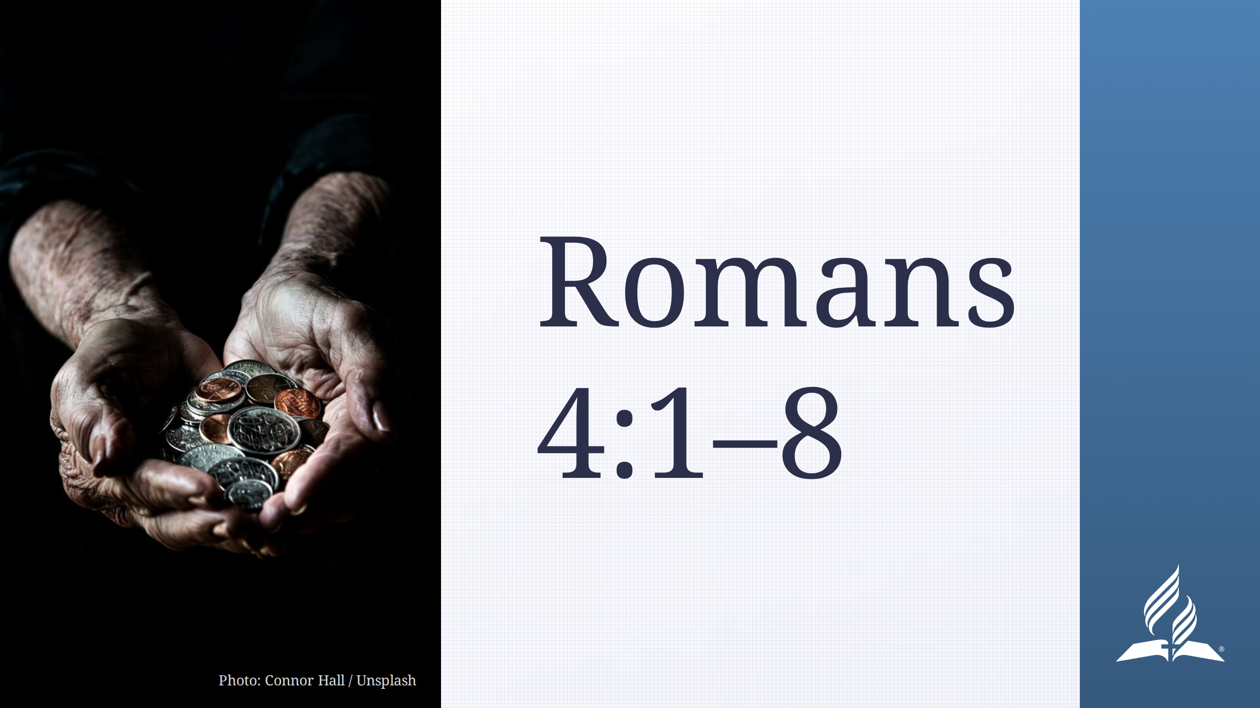
Notes:
If we work for salvation, it becomes a debt God owes us instead of a gift He
gives us.
Instead, when we accept God's gift by faith, THAT is what is counted as
righteousness.

Slide 5
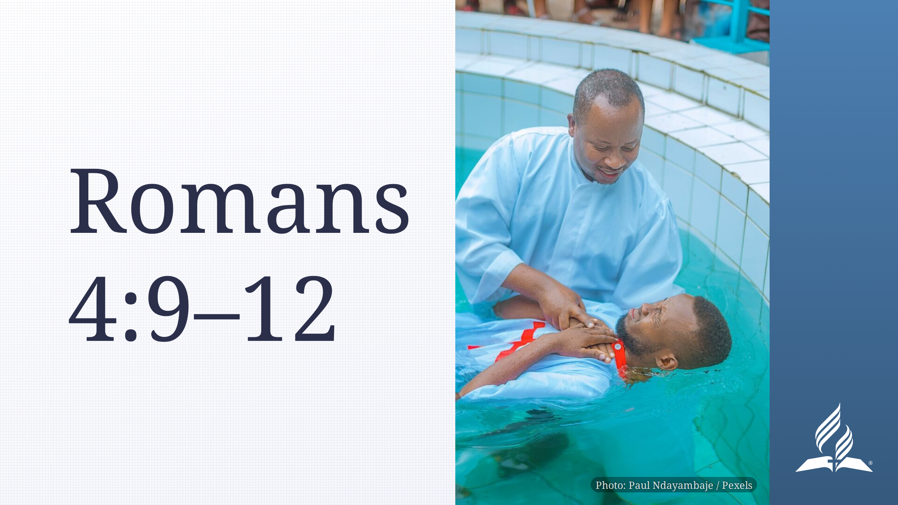
Notes:
What's all this about circumcision? Let's make a different analogy: Instead
of circumcision, let's read baptism.
- Remember, circumcision was the sign of the covenant. In Paul's day it marked
someone as a Jew. In the church today, baptism is the sign of conversion. It
marks someone as a member of the body of Christ. So even though Abraham
wasn't baptized, we can think of the two—circumcision and baptism—as
equivalent.
Now, we can think of Paul asking whether righteousness comes before or after
baptism.
Righteousness comes BEFORE baptism, and it comes by faith. Being baptized,
being a church member, or living the right way doesn't make you righteous.

Slide 6
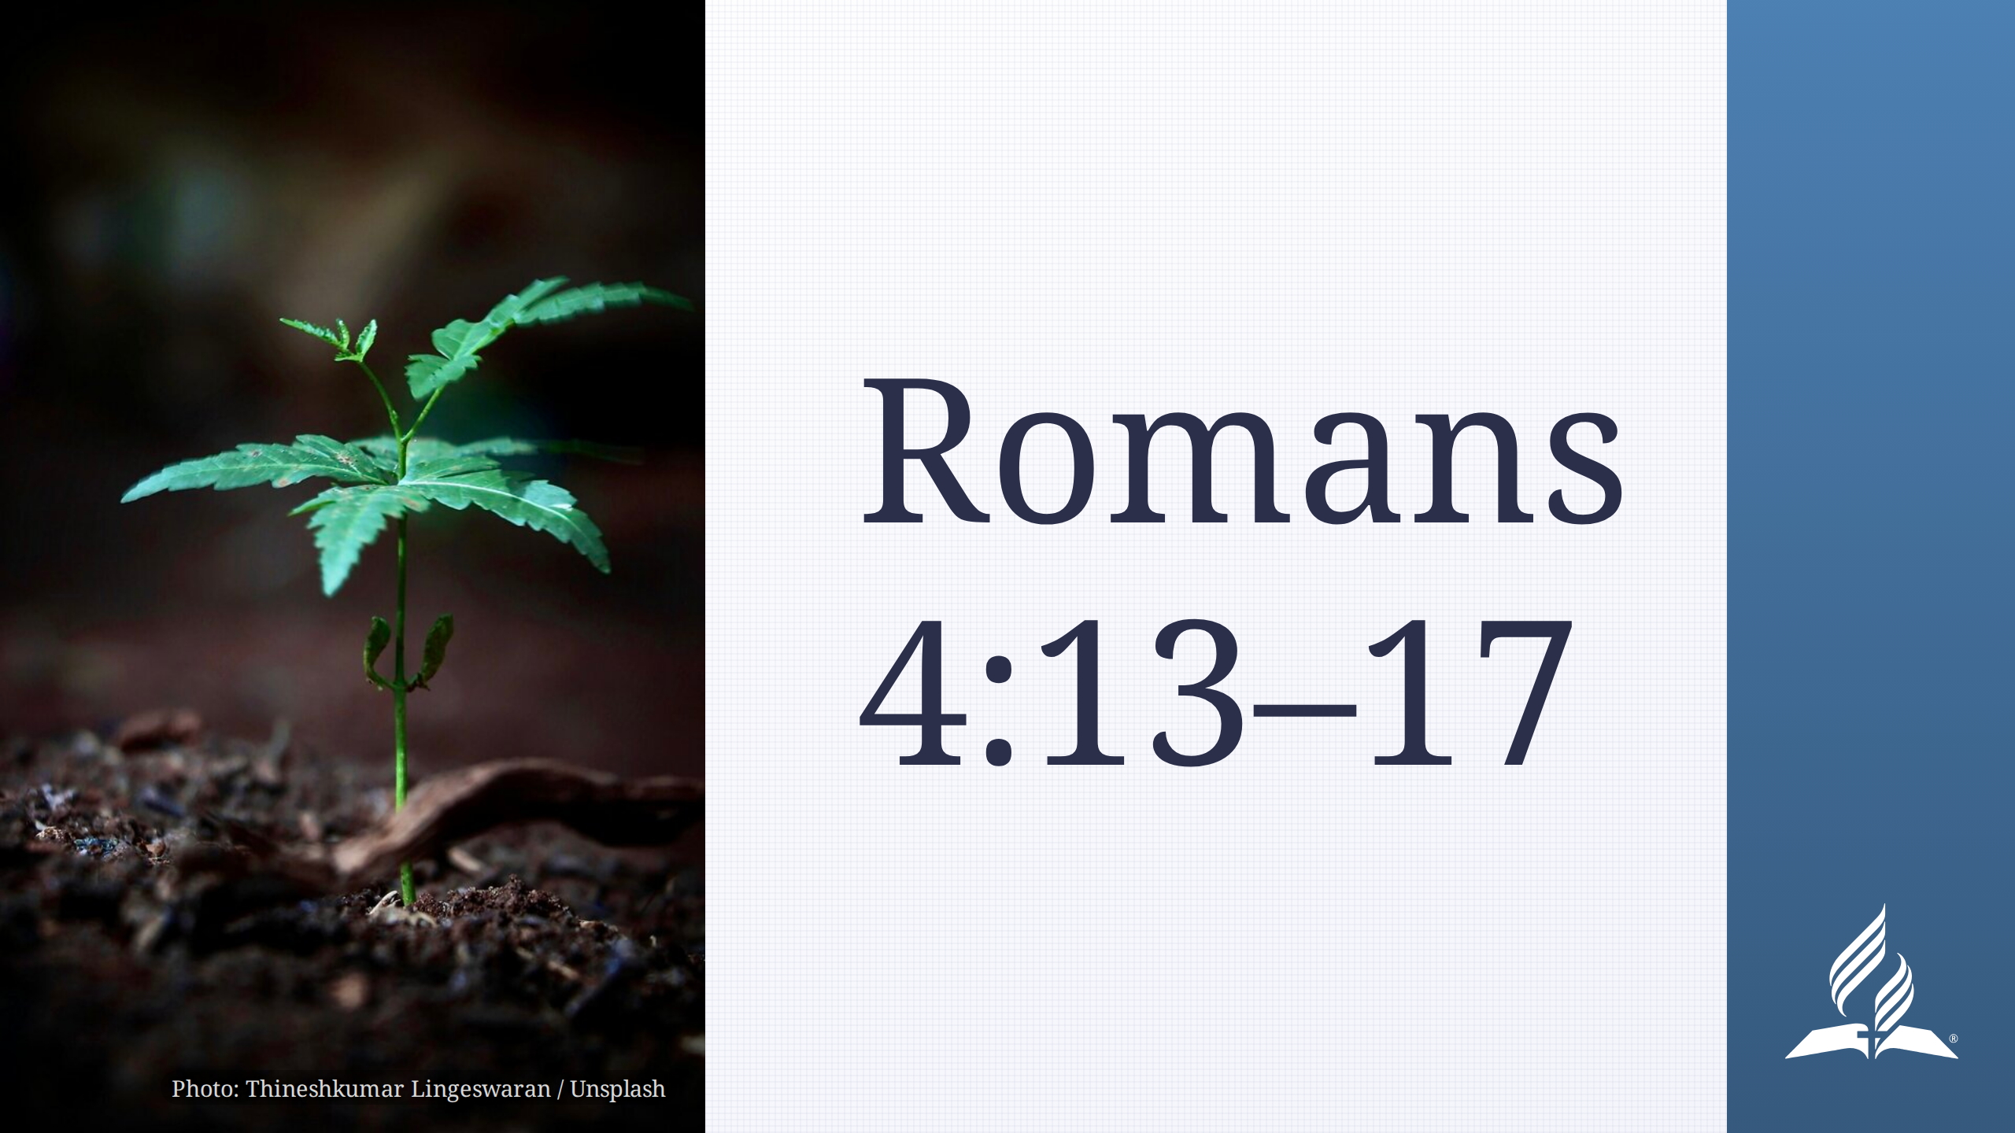
Notes:
God's promise depended on faith, not on the law.

Slide 7
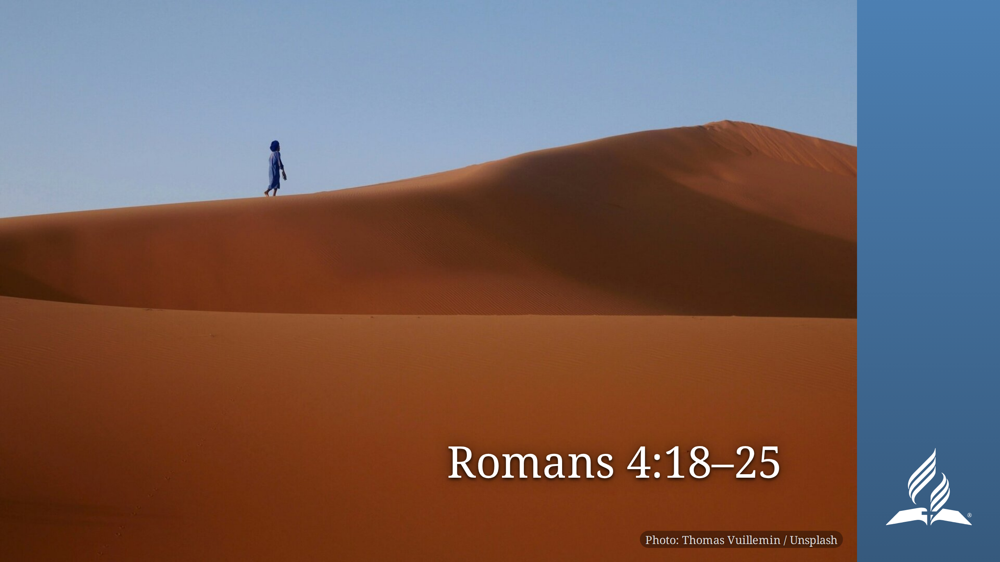

Slide 8
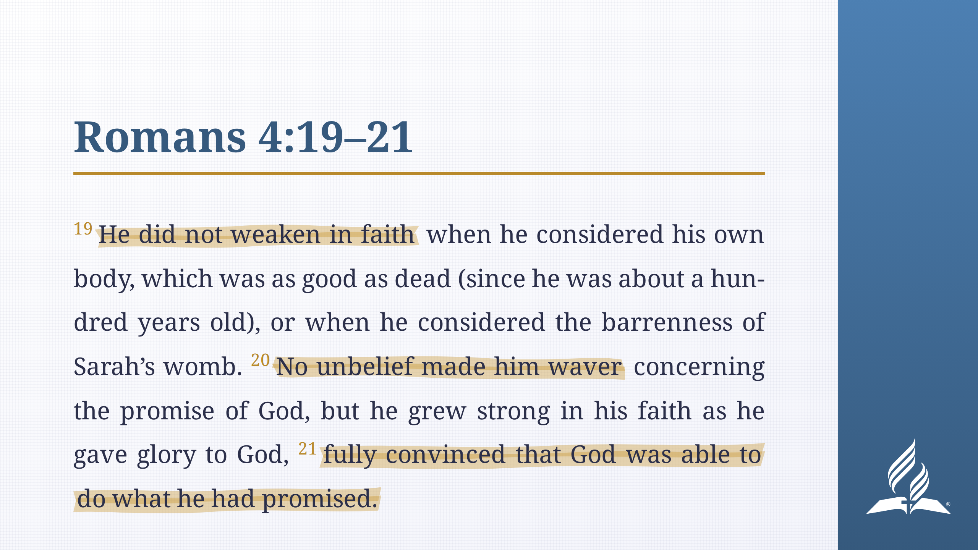
Notes:
_transition: flip
Notice what the text says about Abraham: "He did not weaken in faith." "No
unbelief made him waver." He was "fully convinced that God was able to do what
He had promised."
Does that match what you remember about the story of Abraham? Let's review:

Slide 9
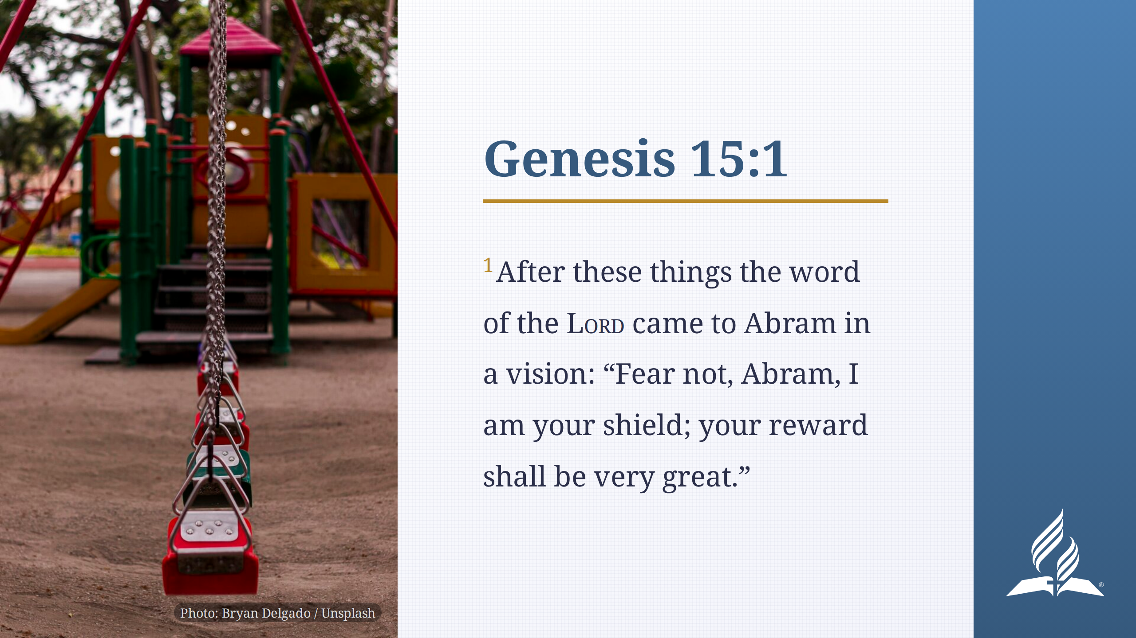
Notes:
God makes Abraham a surprising promise, but Abraham believes and is counted
righteous—the same sentence Paul uses repeatedly.

Slide 10
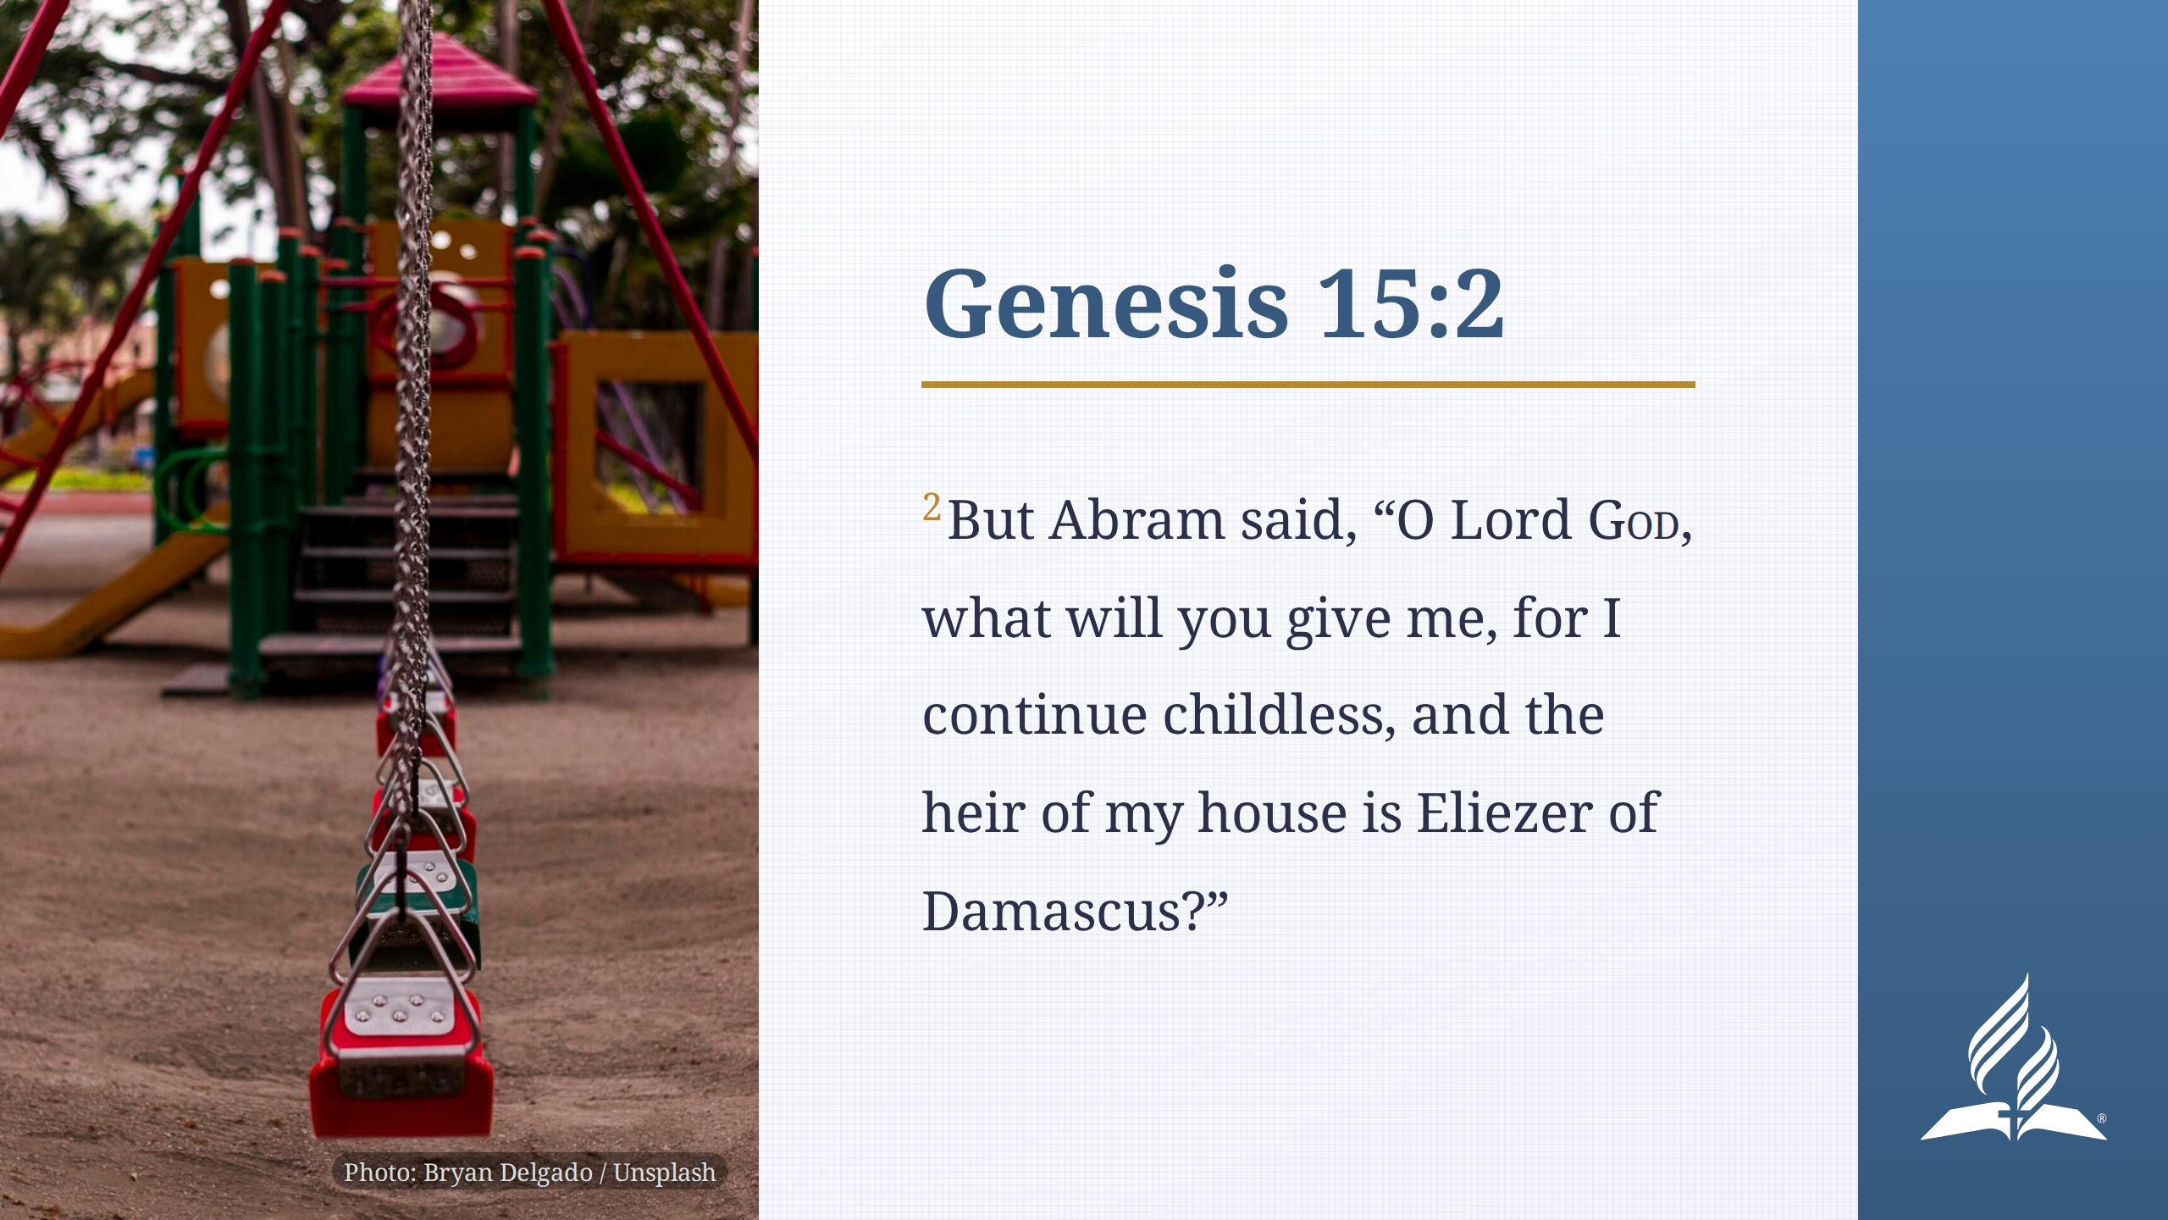

Slide 11
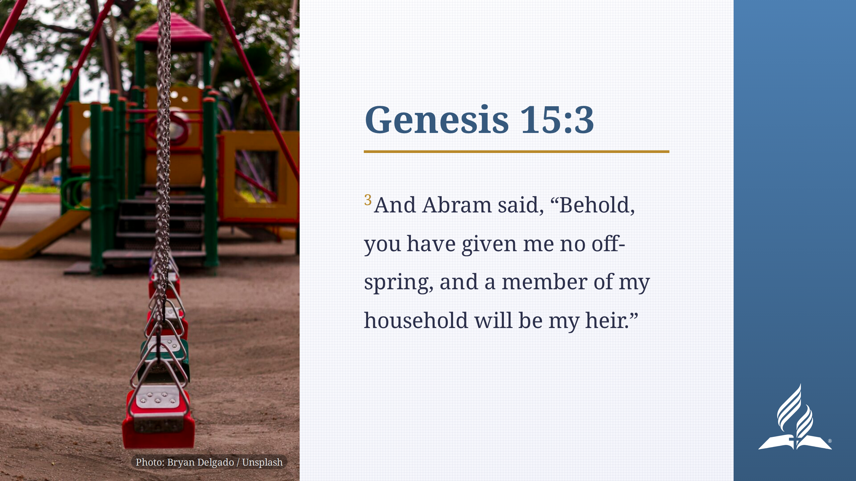

Slide 12
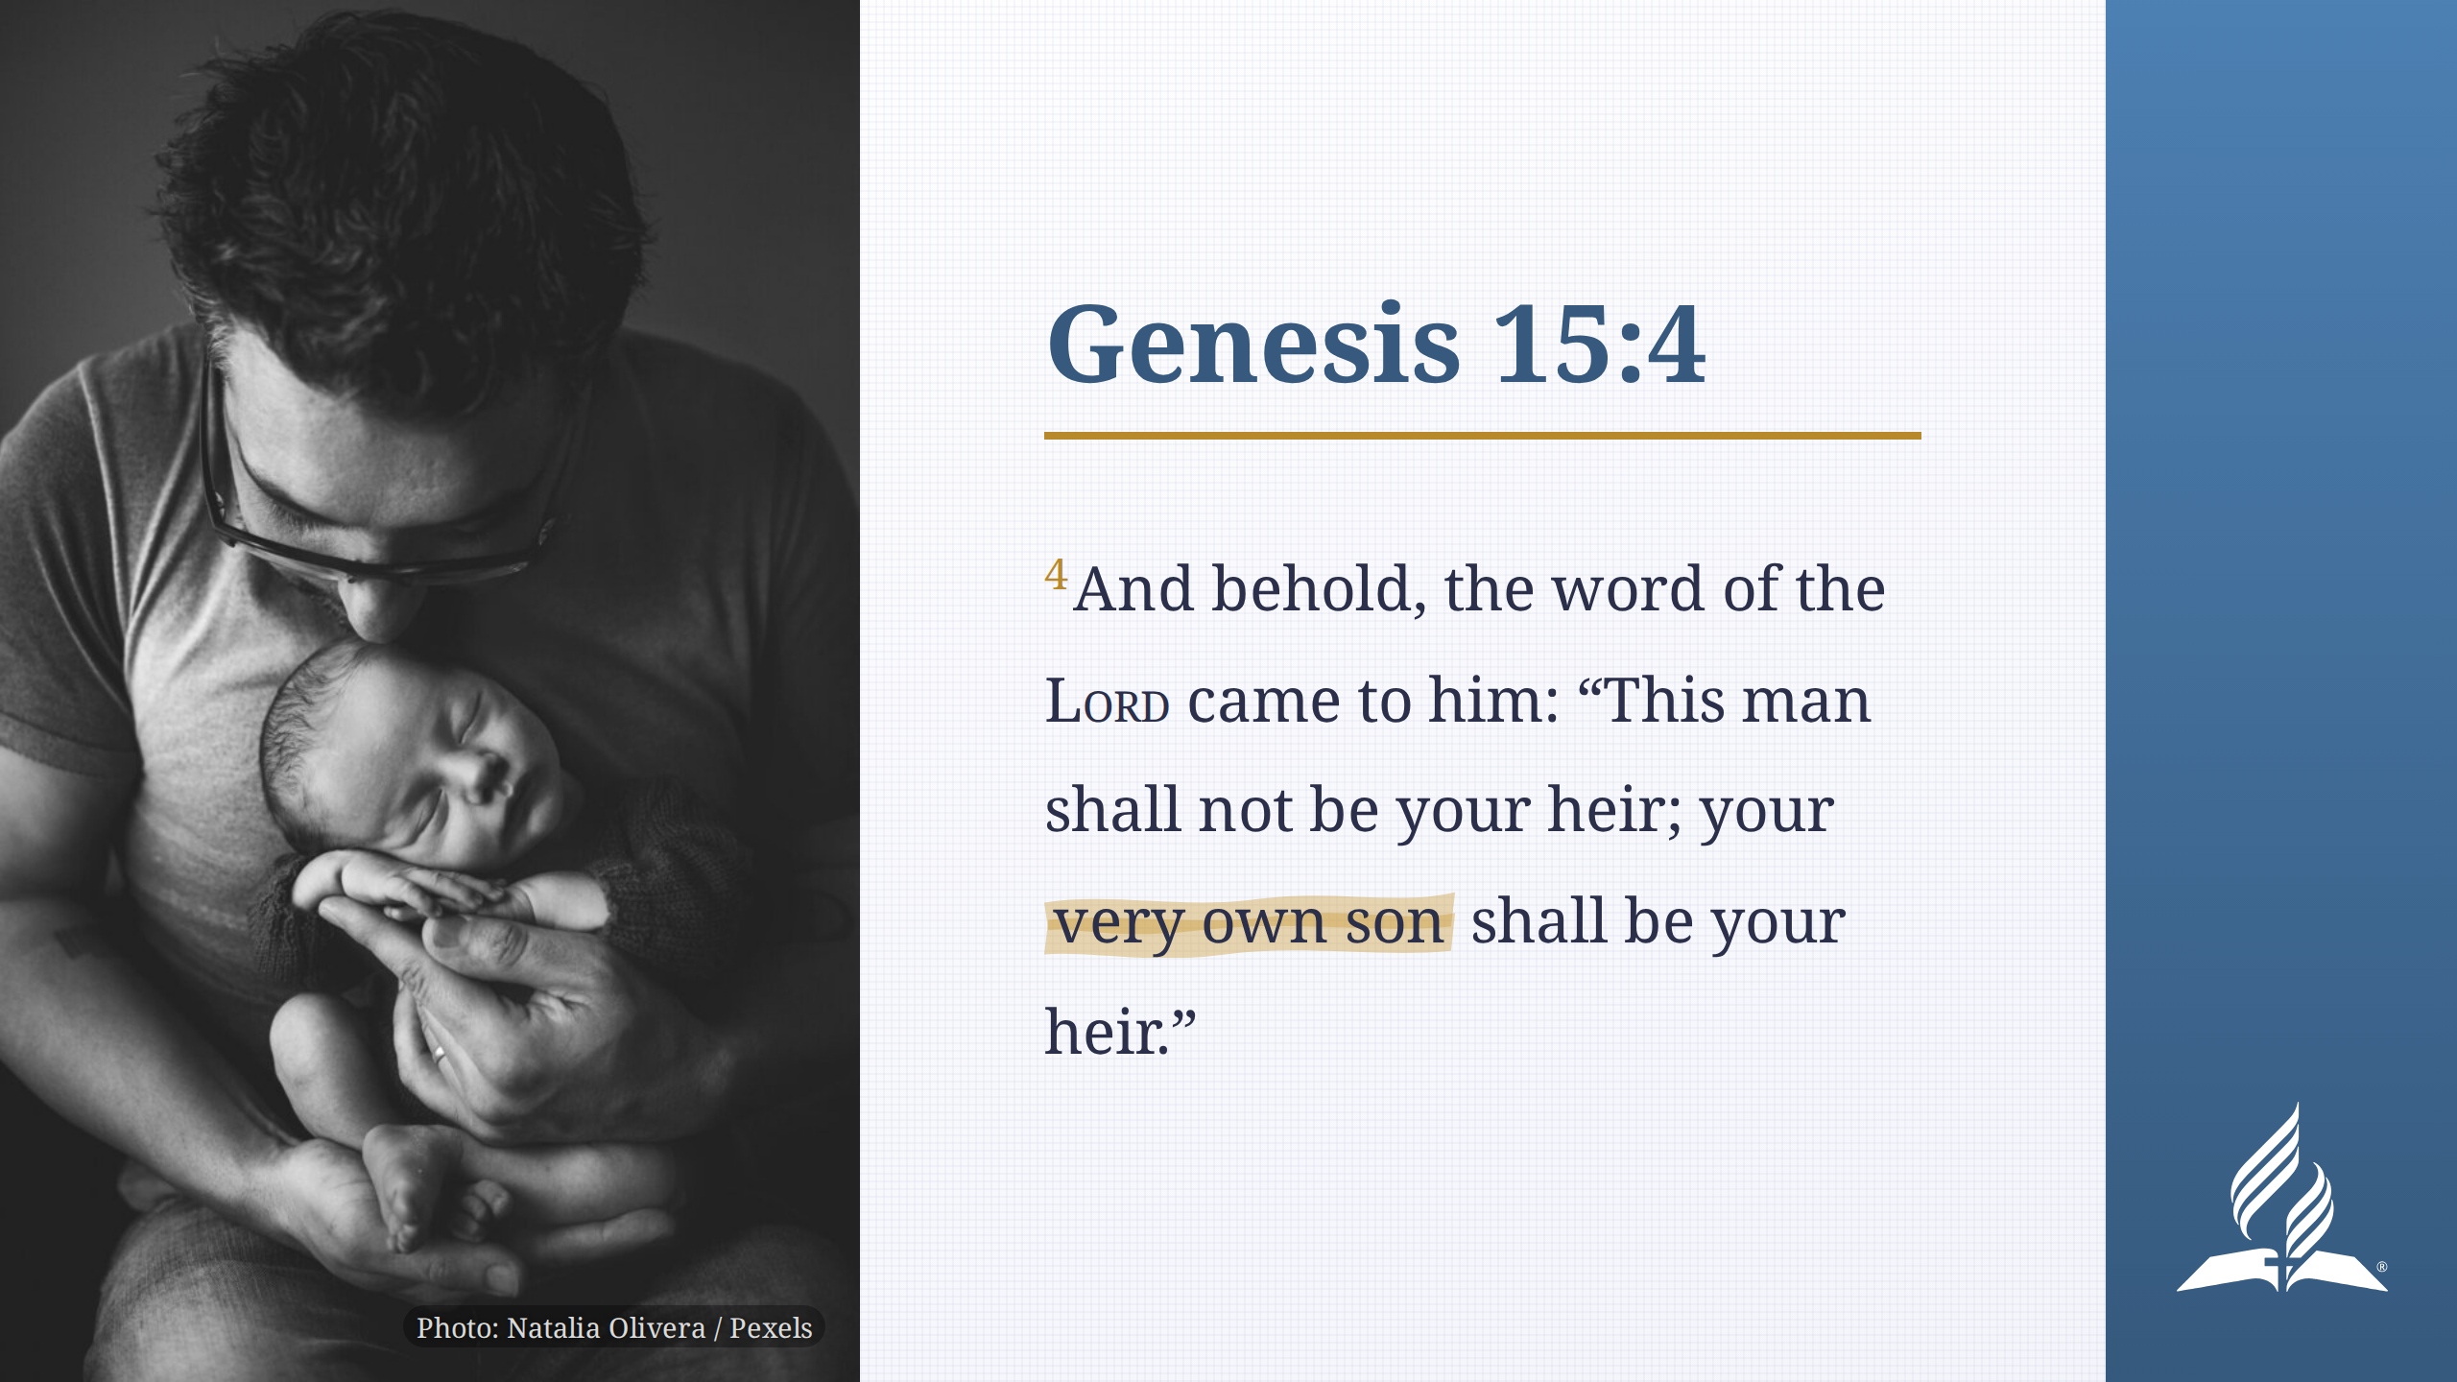

Slide 13
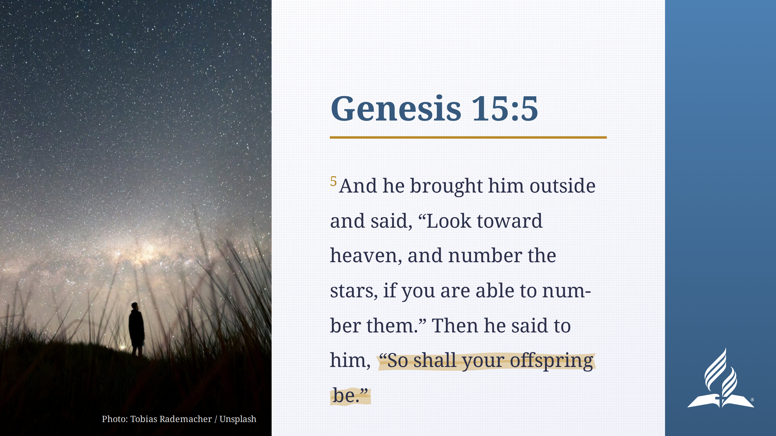

Slide 14
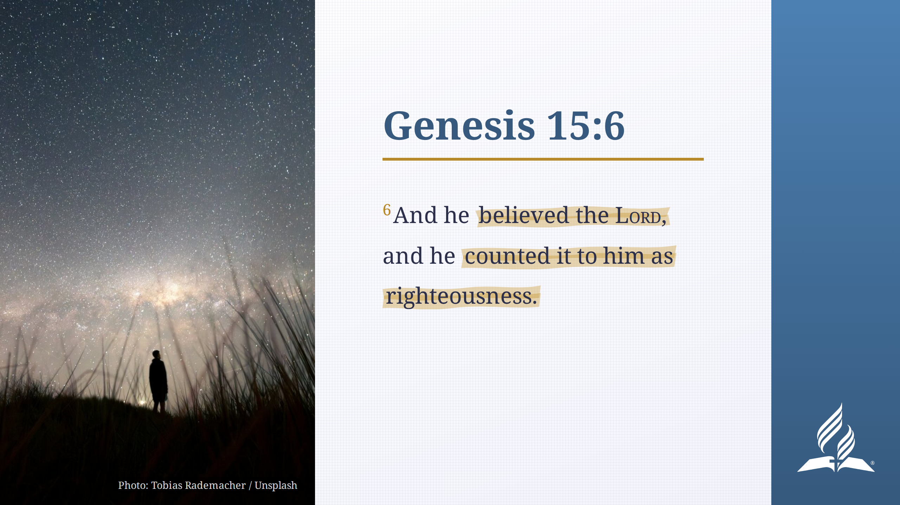

Slide 15
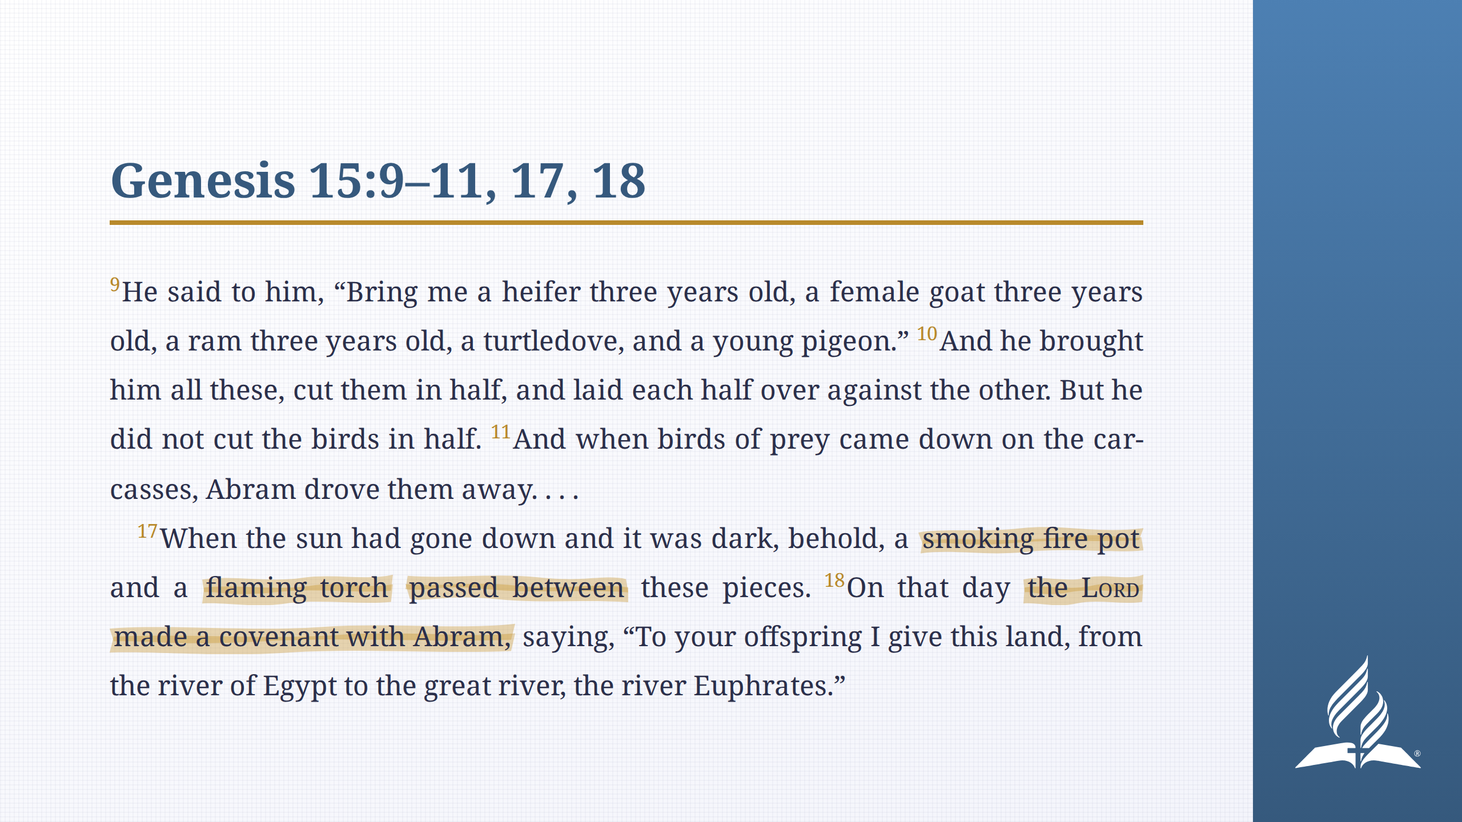
Notes:
This covenant imagery is far removed from us, so it requires some
explanation.

Slide 16
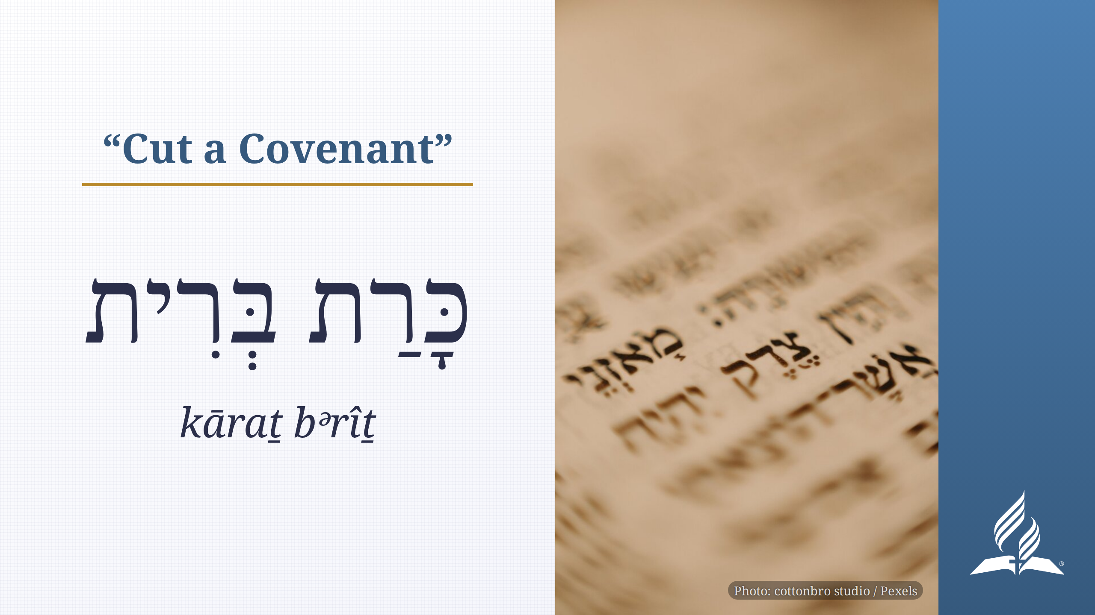
Notes:
In Hebrew, you don't say "sign a covenant" or "ratify a covenant." Instead,
you say כָּרַת בְּרִית (kāraṯ bᵊrîṯ), literally "cut a covenant."

Slide 17
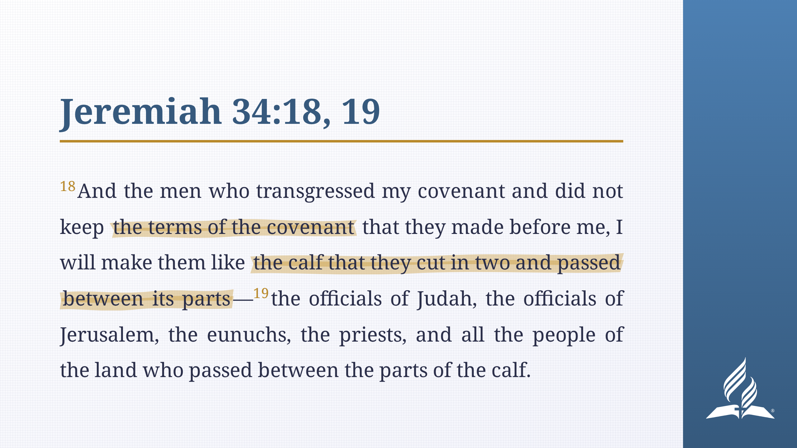
Notes:
Jeremiah 34:18, 19 carries more details of the custom. The parties to a
covenant would cut sacrificial animals in two, arrange them in two rows, then
walk between them as a way of signing the covenant. The meaning was along the
lines of "May I become like these animals if I violate this oath."

Slide 18
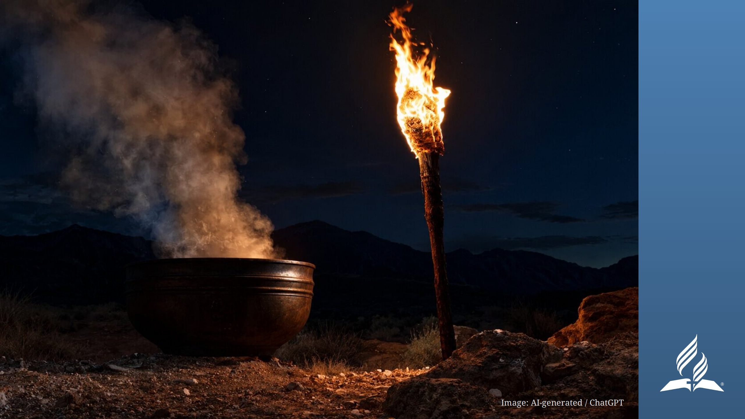
Notes:
_transition: drop
Back to Abraham. Notice what passed between the animals. It wasn't God and
Abraham. Abraham was a witness to the covenant, but he wasn't a party to it.
Instead, two objects that could symbolize God (think pillar of fire/cloud)
passed between the animals.

Slide 19
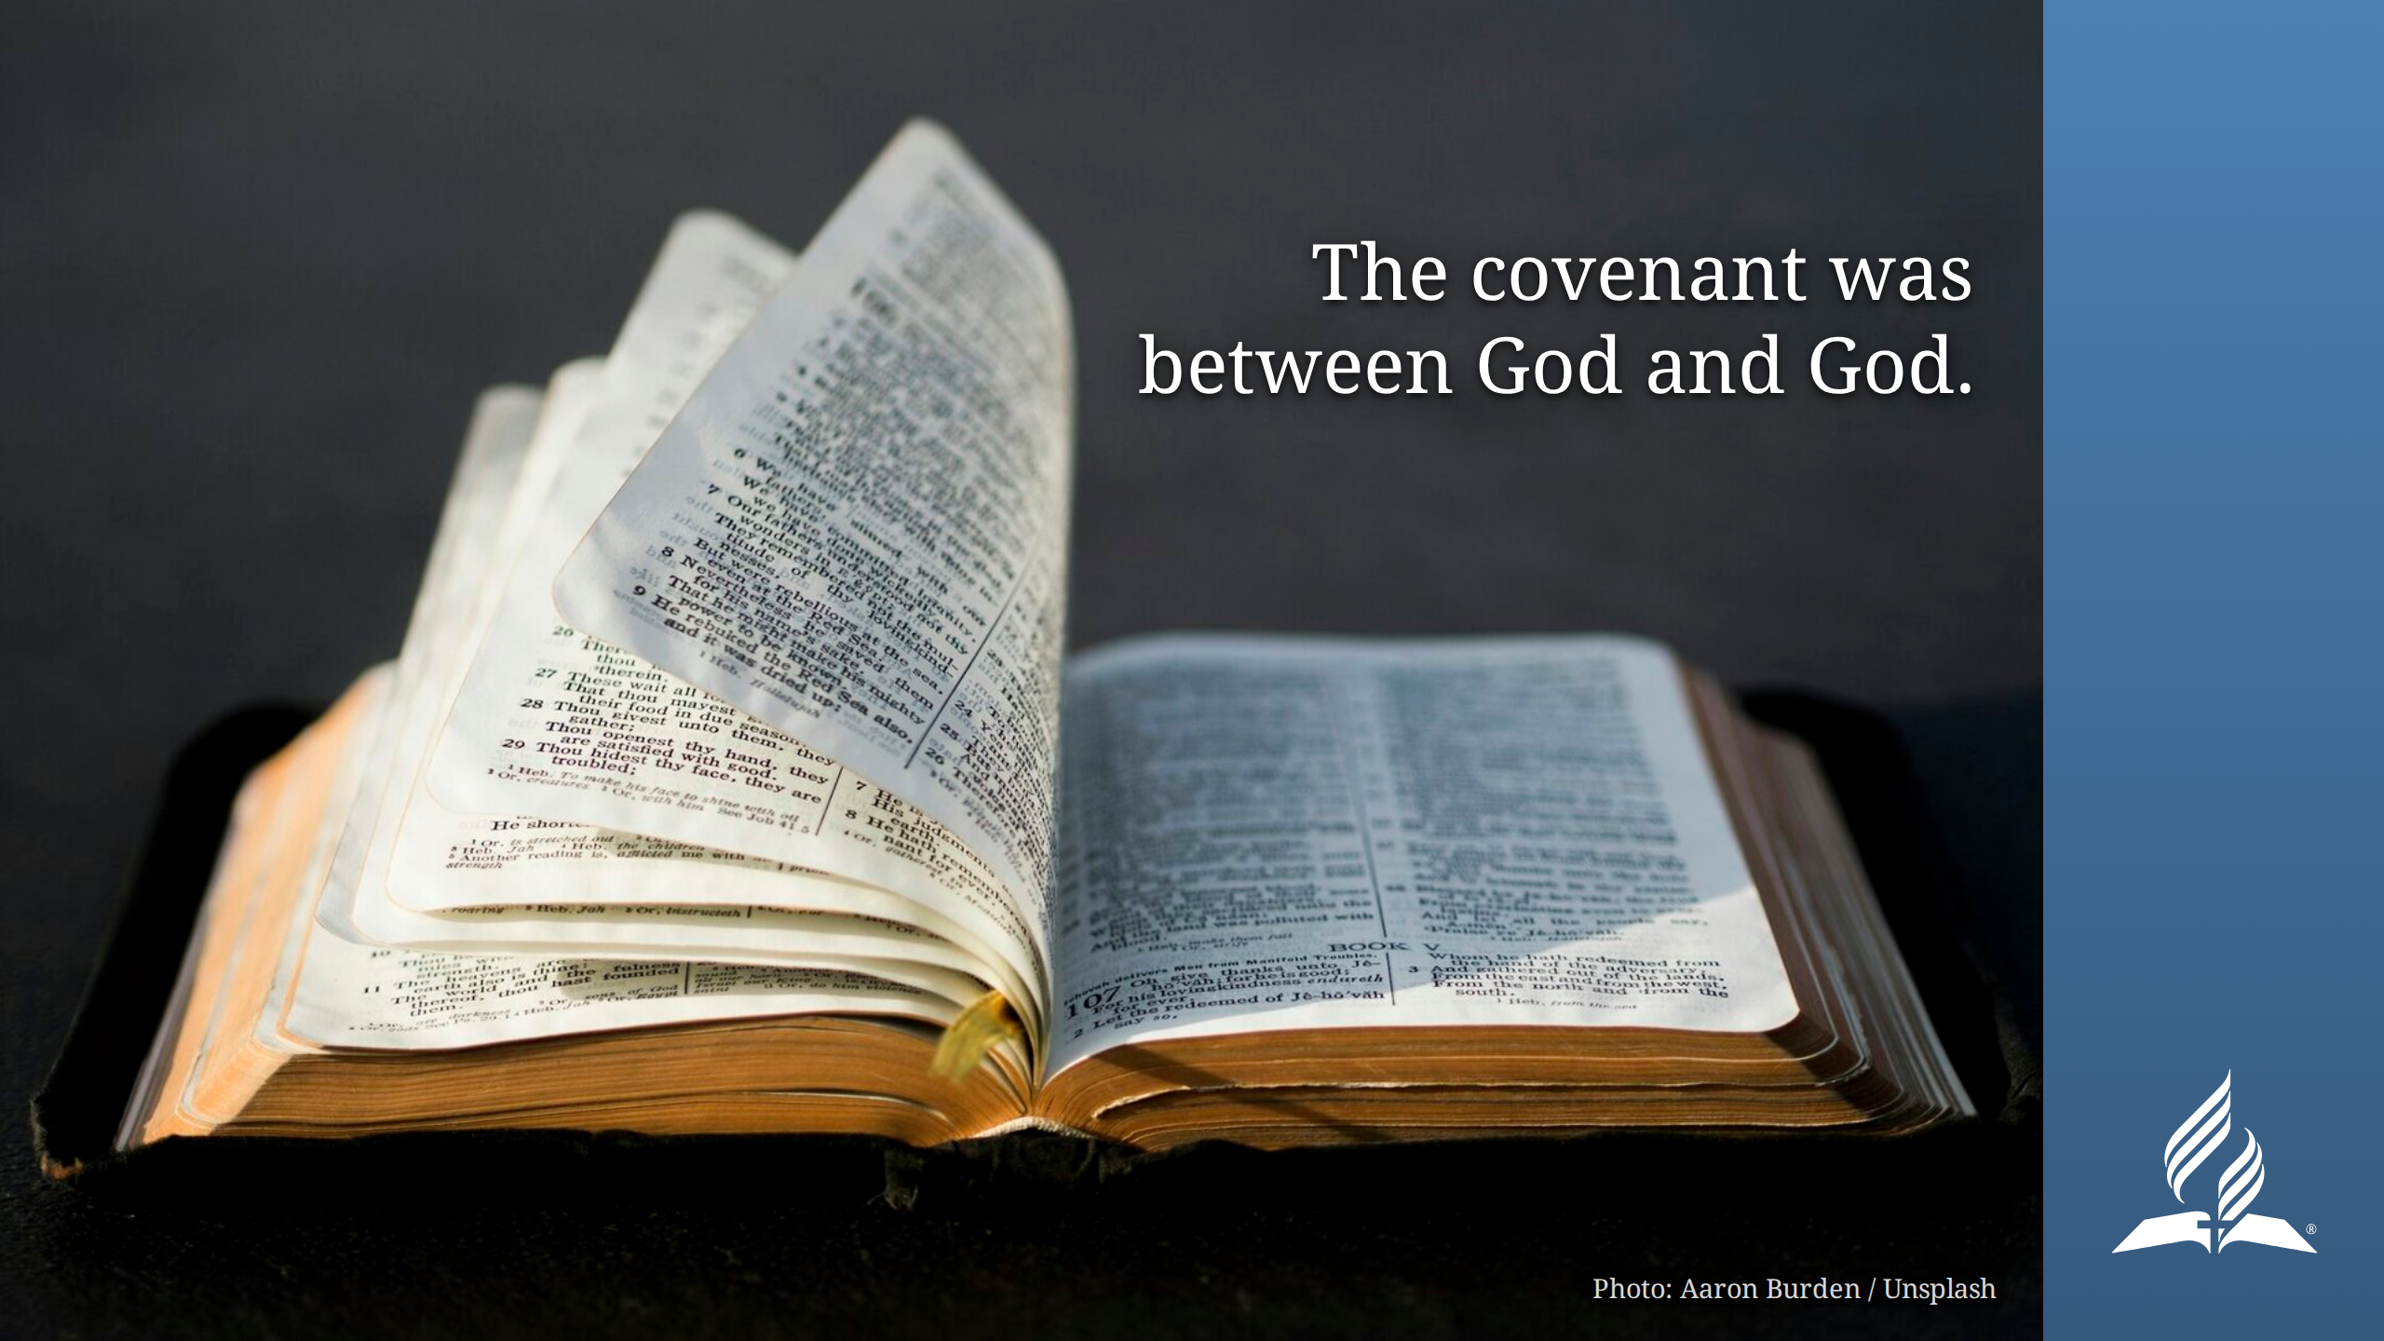
Notes:
Thus, the covenant was between God and God. This covenant, which Abraham
believed and was counted righteous for believing, was God's covenant with
Himself. Abraham's job was to believe God, not to perform the covenant.
So, Abraham believed God and it was counted as righteousness. So far, so good.
But what about his behavior?
In the very next chapter of Genesis, right after Abraham believes God's promise
to make a nation of his descendants, we find the story of Hagar and Ishmael.

Slide 20
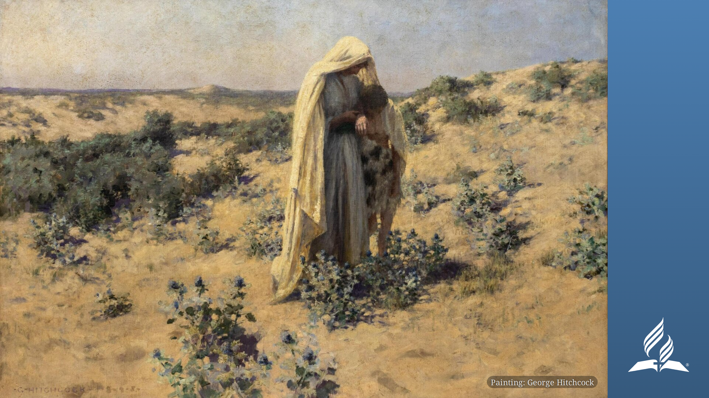
Notes:
_transition: flip
Abraham, at Sarah's instigation, doubts God's promise and tries to have a
child through illicit means, trying to fulfill God's promise on his own.

Slide 21
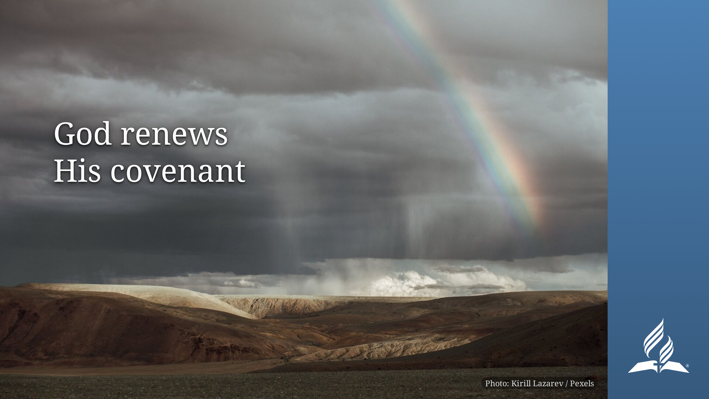
Notes:
Years pass and God once again renews His covenant (Genesis 17:1-10). This
time He does place a requirement on Abraham: circumcision.
How does Abraham respond?

Slide 22
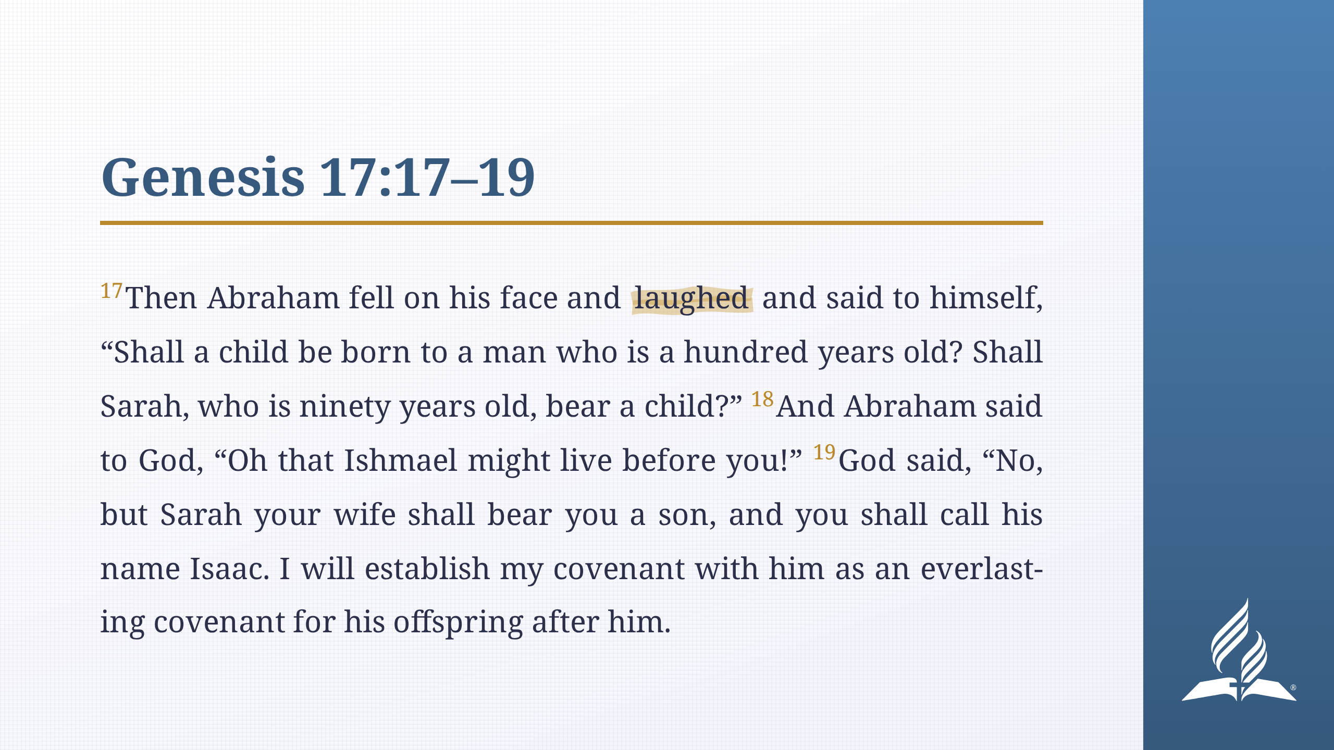
Notes:
_transition: explode
Abraham has been waiting so long (Ishmael is 13 years old at this time) that
he's having a hard time believing God.
So we've seen that Abraham certainly had some trouble trusting God's promise.

Slide 23

Notes:
Back to Romans 4:19-21. How can we reconcile what Paul says about Abraham
with what we just read in Genesis?
Remember two things:

Slide 24
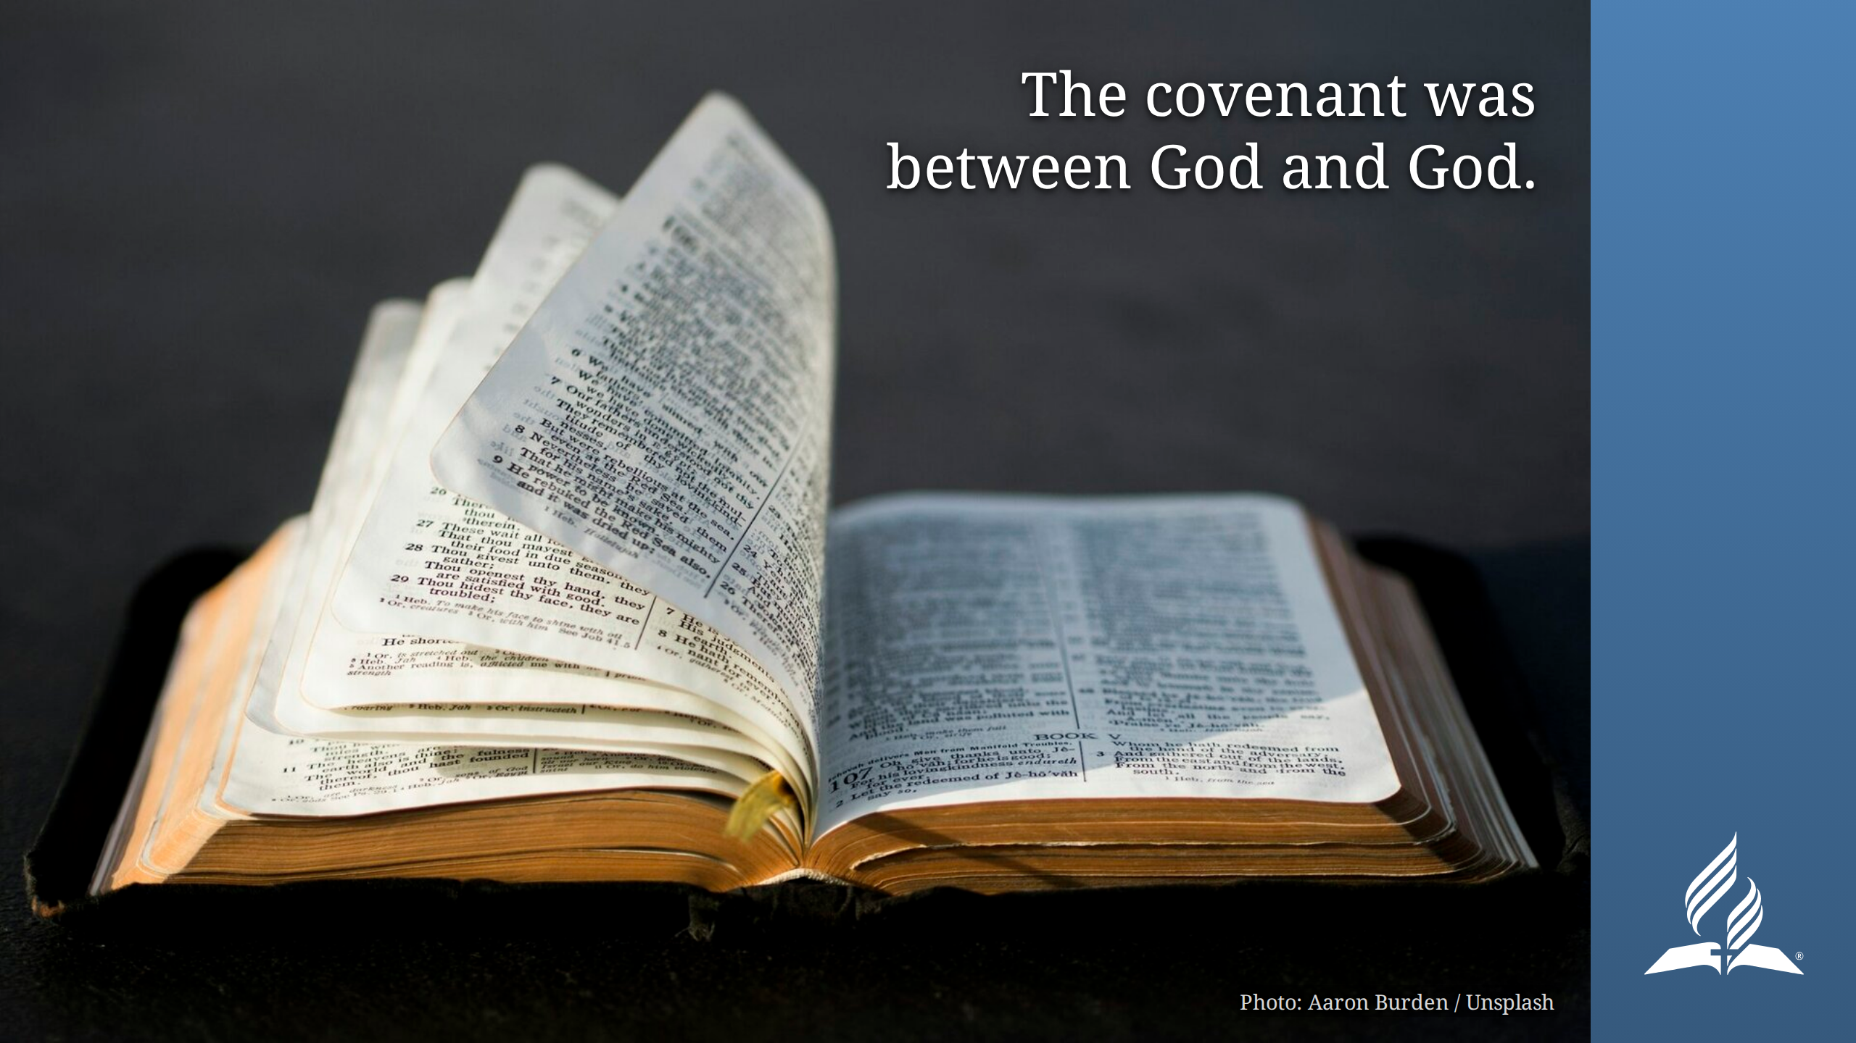
Notes:
The covenant was between God and God. It wasn't a matter of Abraham's
performance.

Slide 25

Notes:
When Abraham believed God, THAT was counted as righteousness. That means
that his slip-ups didn't change where his righteousness came from.
Paul can say Abraham never wavered—not because that was literally true, but
because God DECLARED it to be true. It was a verdict on Abraham's faith as a
whole.

Slide 26
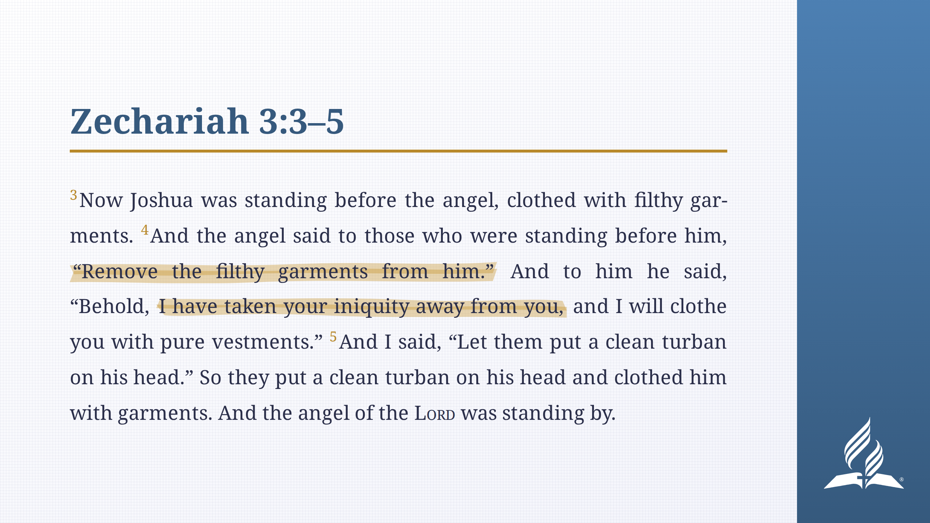
Notes:
God takes our sin and filth, and HE is the one who cleans us and declares us
to be righteous.
HIDDEN SLIDE: Isaiah 64:6. Not rendered. To restore, move this out of
the comment, put a --- line above the heading, and keep the Romans 4:3 slide
after it.
# Isaiah 64:6
<p class="poetry">
<span class="line indent-0"><span class="verse-number">6</span>We have all become like one who is unclean,</span>
<span class="line indent-1">and <span class="highlight-narrow">all our righteous deeds are like a polluted garment.</span></span>
<span class="line indent-0">We all fade like a leaf,</span>
<span class="line indent-1">and our iniquities, like the wind, take us away.</span>
</p>
cf. Isaiah 64:6 (original speaker note)

Slide 27
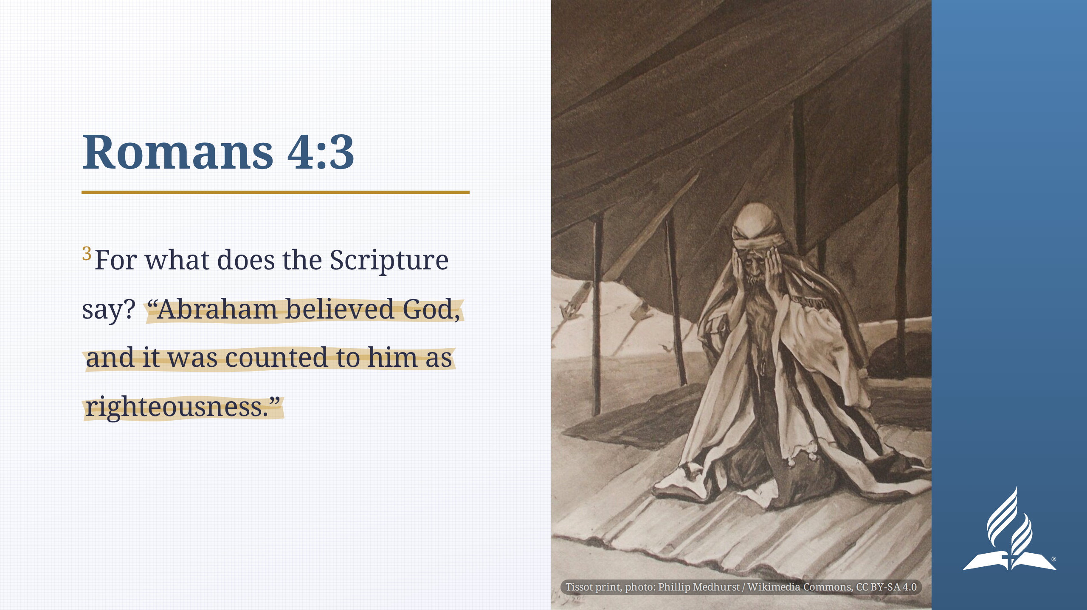
Notes:
Thus, "Abraham believed God, and it was counted to him as righteousness"
(Romans 4:3).
By the way, believing God doesn't mean you never have any questions. But you
can choose to take God at His word even if you don't understand it and still
have doubts and questions.
So what does this all mean for us?

Slide 28
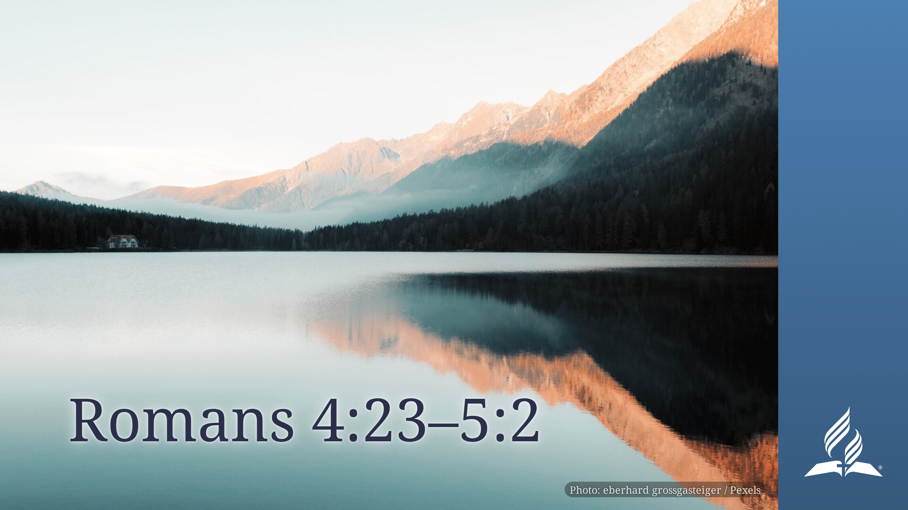
Notes:
If you have accepted God's offer of salvation by faith, then you are
righteous. Not because you feel righteous, not because you meet God's
performance targets.
So many people say that they believe that we are saved by grace through faith
and not by works, yet their spiritual focus doesn't show it.
- We sometimes judge our standing before God based on how the day went. Or the
week. Or the month, etc.
The question is, will you believe God?
We do need to address sin briefly, even though that isn't our topic for today.
- Paul spends the next three chapters explaining that God's grace doesn't make
sin OK (e.g., Romans 6:1, 2).
- But the point that Paul makes repeatedly is that God's grace is what is truly
transformational in our lives. In other words, believing God is far more
powerful than shunning sin.

Slide 29
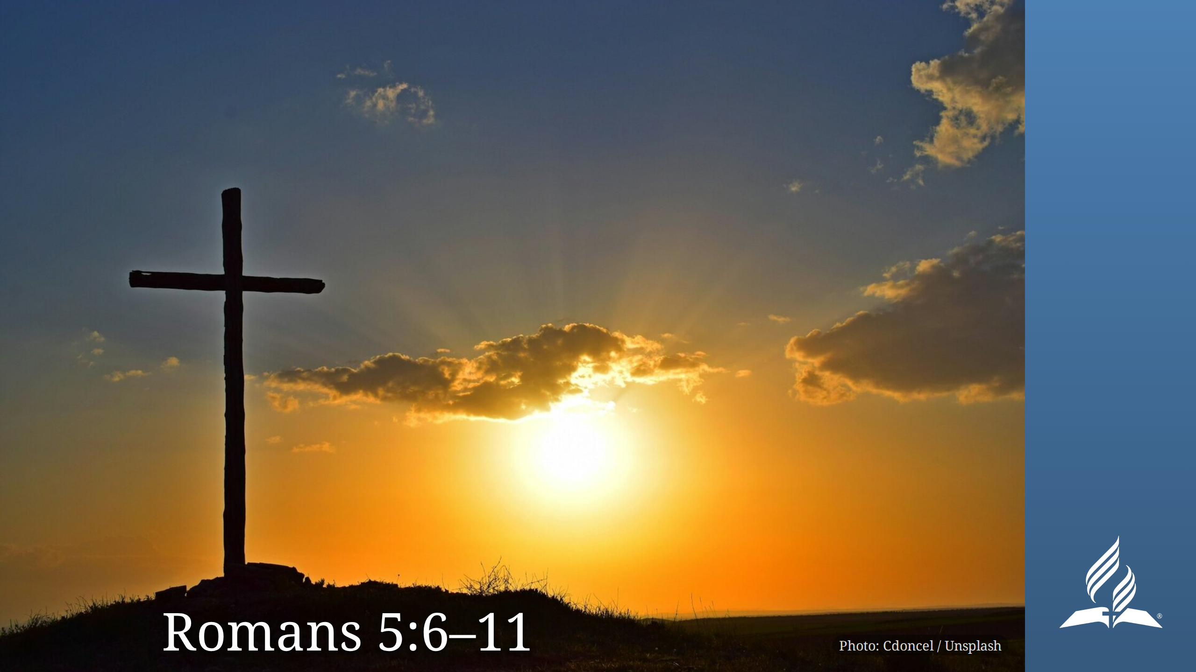
Notes:
_transition: drop
When we believe God, we are reconciled to God, and that's the source of
power.

Slide 30


